Slide 1


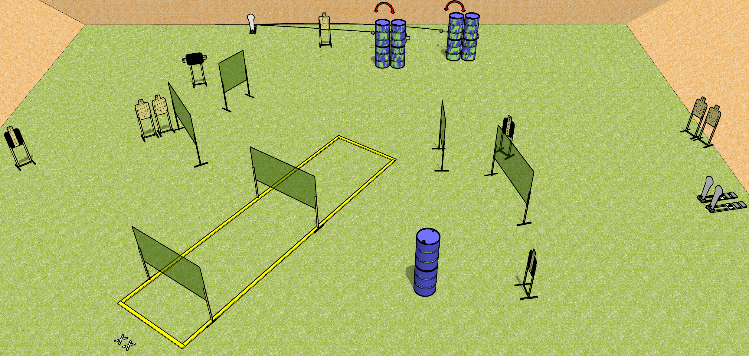
 | Dothan Gun Club – USPSA Match Speed Brake Course Designer : Patrick Free
START POSITION : Standing with both feet on X’s, wrists above shoulders
GUN READY CONDITION : Pistol loaded and holstered. PCC loaded, held with both hands, stock on belt, safety on. |  | SCORING: Comstock, 27 rounds TARGETS: 12 paper, 3 Steel SCORED HITS: Best 2 on paper, steel until down START-STOP: Audible, last shot RULES:
STAGE PROCEDURE: Engage targets as they become available from within the fault lines.

Slide 2
Speed Brake
Written Stage Briefing
Speed Brake is a 27 round, 135 point, Comstock field course. There are 12 USPSA targets and 3 Colt poppers. The best two hits on paper will score and steel must fall to score. The start signal is audible.
The swingers are activated by the leftmost colt popper and are not disappearing targets. Please check the activators prior to walkthrough and set them the same way every time.
Handgun start position is both feet on X’s, wrists above shoulders. Handgun is loaded and holstered.
PCC start position is both feet on X’s. Loaded carbine is held with both hands, stock on belt, safety on.
On start signal, engage targets as they become available from within the shooting area.

